Slide 1

United Parents & CalHOPE
Steve Varner
FEMA Program Coordinator
United Parents
888.384.1120, ext. 32

Slide 2
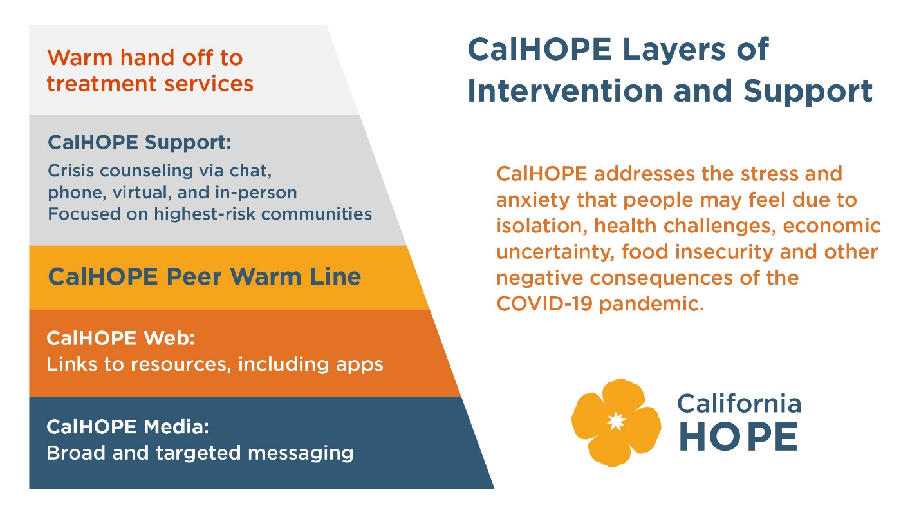
CalHOPE Layers of Intervention and Support

Slide 3
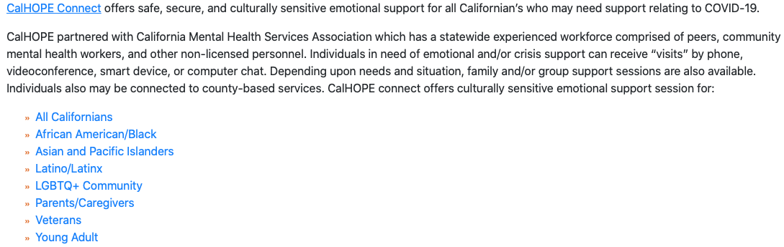
CalHOPE Connect

Slide 4
United Parents & Ventura County
As of August 5th we have 20 highly trained Crisis Counselors (10 English speaking & 10 Spanish speaking) who are taking live chats, phone calls, distributing flyers, visiting local businesses & vaccination sites, emailing schools & government agencies, facilitating support groups and engaging on all social media platforms to 20,845 parents & caregivers in the State of California.
We are open from 9am to 7pm Monday thru Friday and 9am to 5:30pm on Saturday. Our direct phone line is: 888.384.1120
We have had direct contact with 4,380 people who are living in Ventura County during this 5 month period.

Slide 5
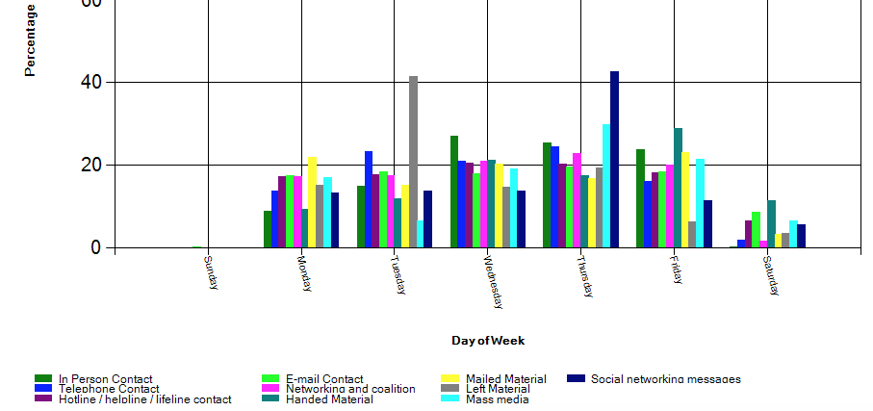
Ventura County Day of the Week Contacts

Slide 6
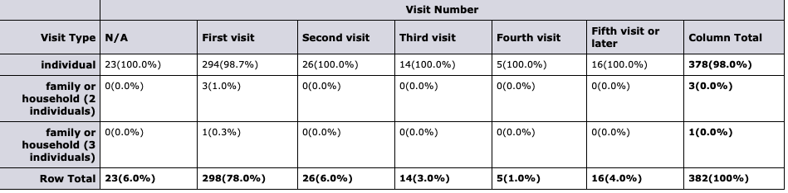
Ventura County ~ 382 Visits Last Week

Slide 7
QUESTIONS ? ? ?

